Slide 1



Retail Analysis Interactive Dashboard
View in Power BI
Last data refresh:
5/26/2023 10:45:28 AM UTC
Downloaded at:
5/27/2023 6:32:37 AM UTC

Slide 2
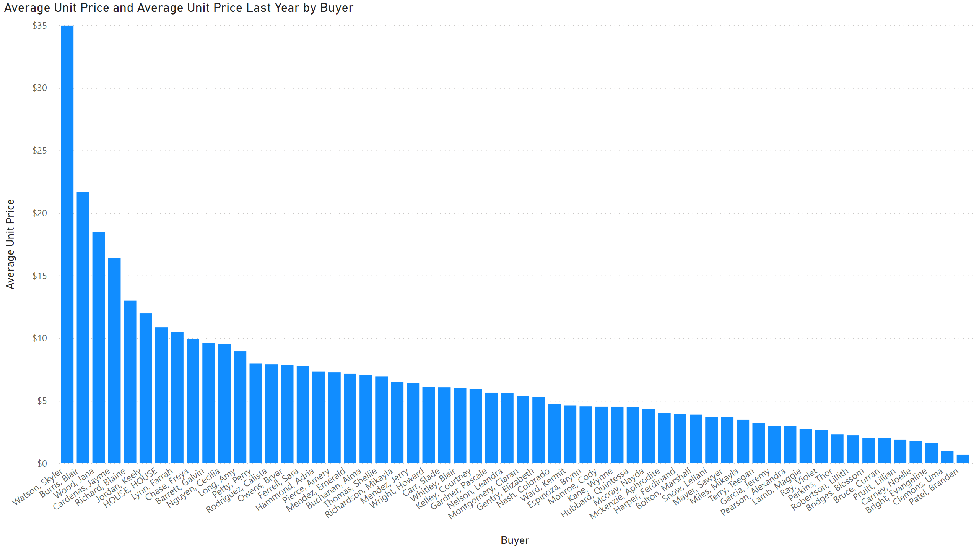
Page 1
Notes:
lineClusteredColumnComboChart
No alt text provided

Slide 3
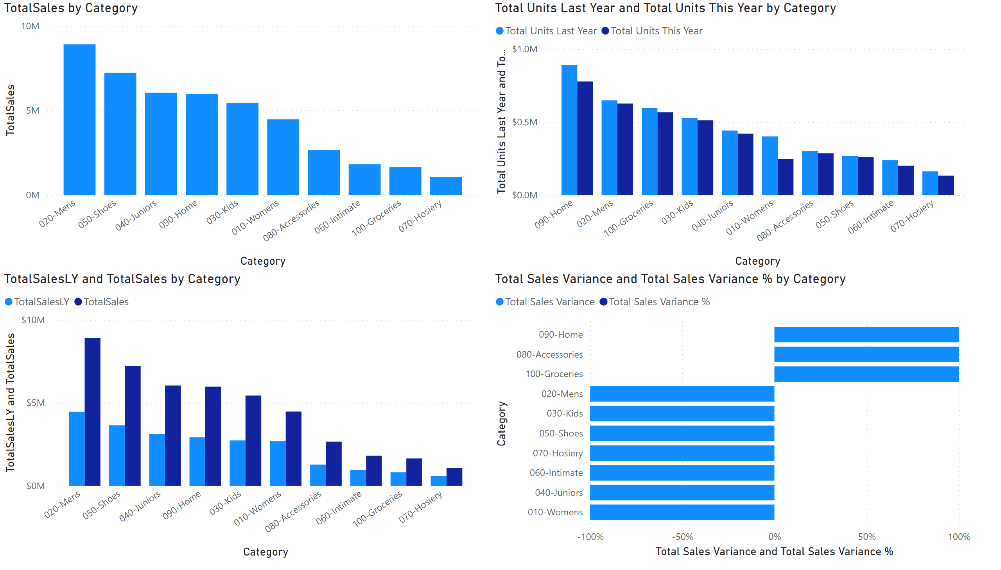
Page 2
Notes:
clusteredColumnChart
No alt text provided
clusteredColumnChart
No alt text provided
clusteredColumnChart
No alt text provided
hundredPercentStackedBarChart
No alt text provided

Slide 4
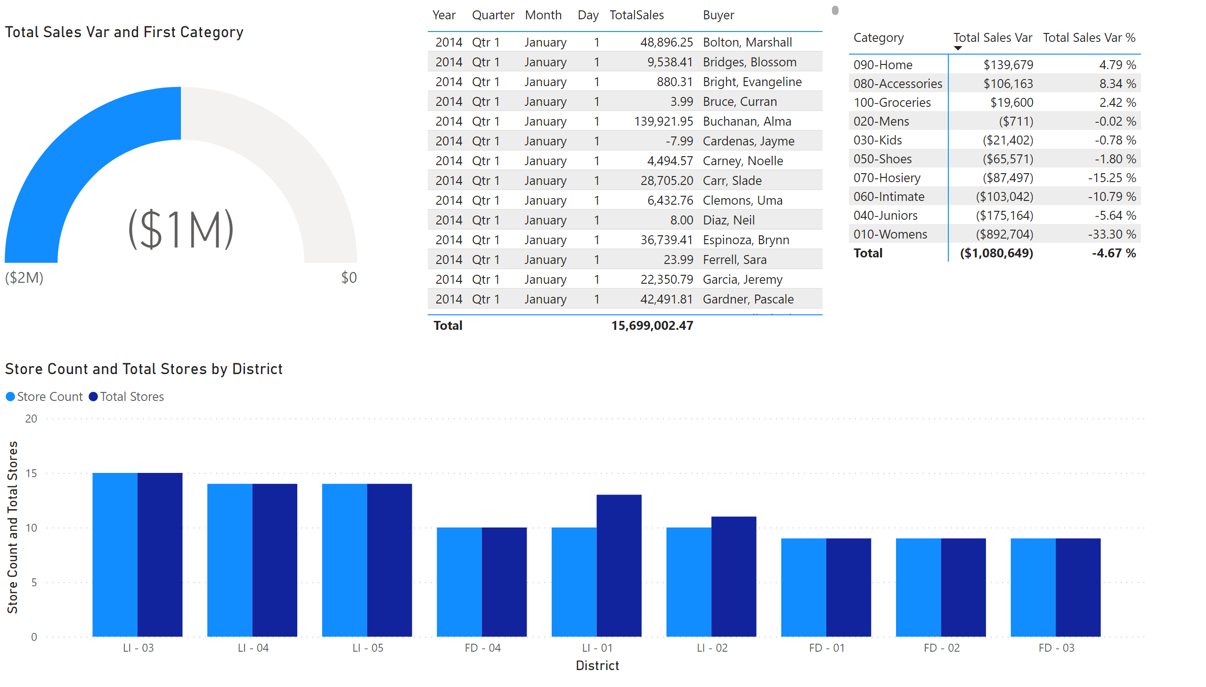
Page 3
Notes:
gauge
No alt text provided
pivotTable
No alt text provided
clusteredColumnChart
No alt text provided
tableEx
No alt text provided

Slide 5
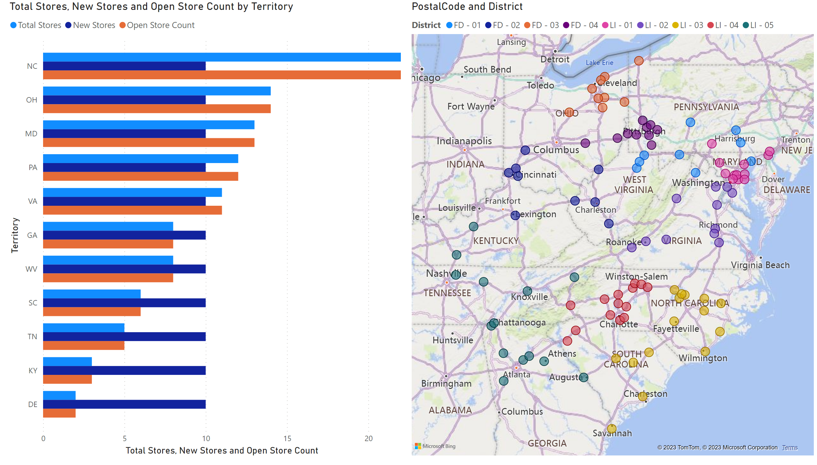
Page 4
Notes:
clusteredBarChart
No alt text provided
map
No alt text provided

Slide 6
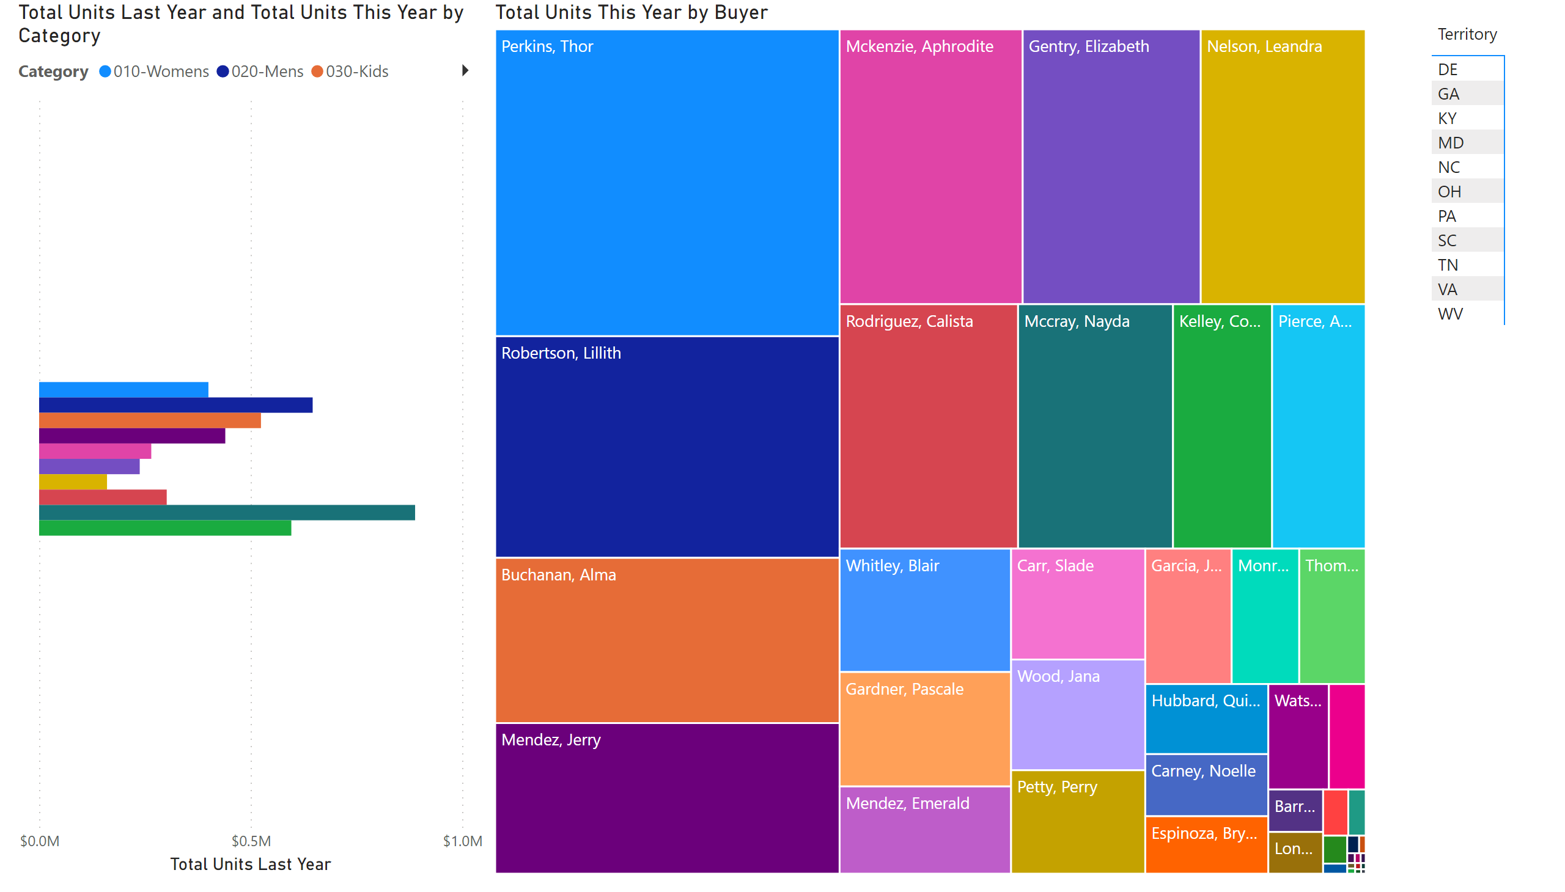
Page 5
Notes:
clusteredBarChart
No alt text provided
treemap
No alt text provided
pivotTable
No alt text provided

Slide 7
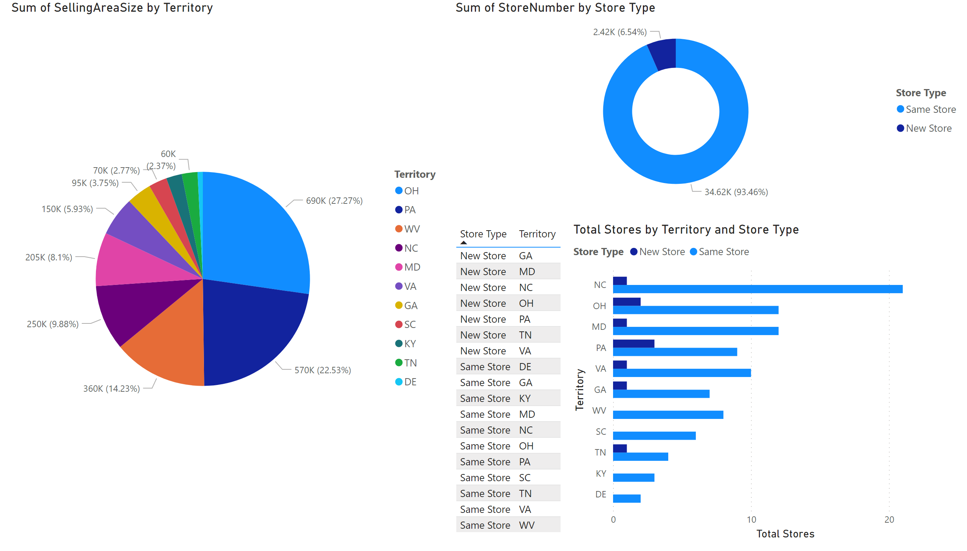
Page 6
Notes:
pieChart
No alt text provided
tableEx
No alt text provided
donutChart
No alt text provided
clusteredBarChart
No alt text provided

Slide 8
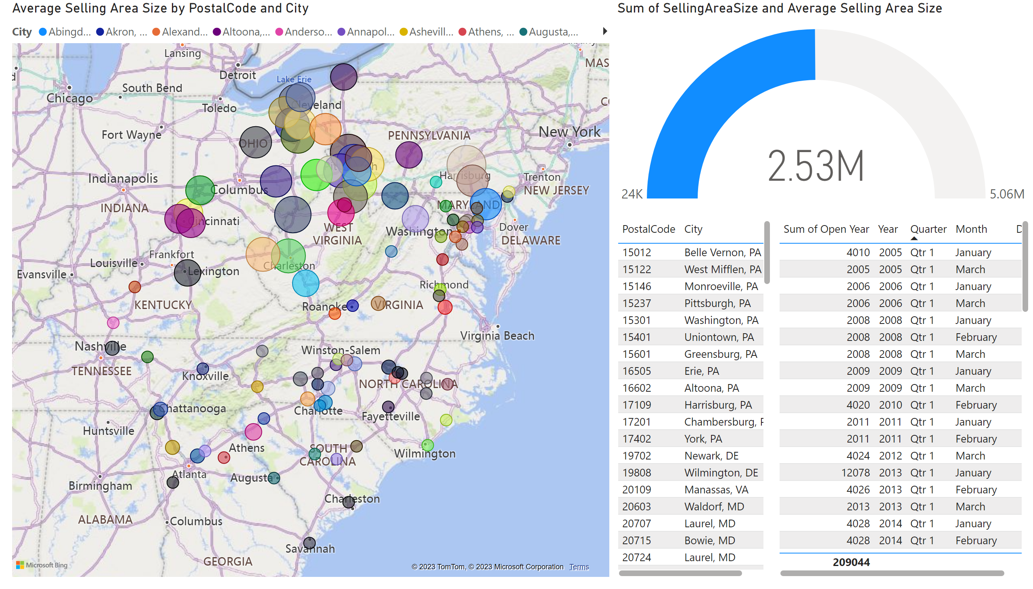
Page 7
Notes:
map
No alt text provided
gauge
No alt text provided
tableEx
No alt text provided
tableEx
No alt text provided

Slide 9
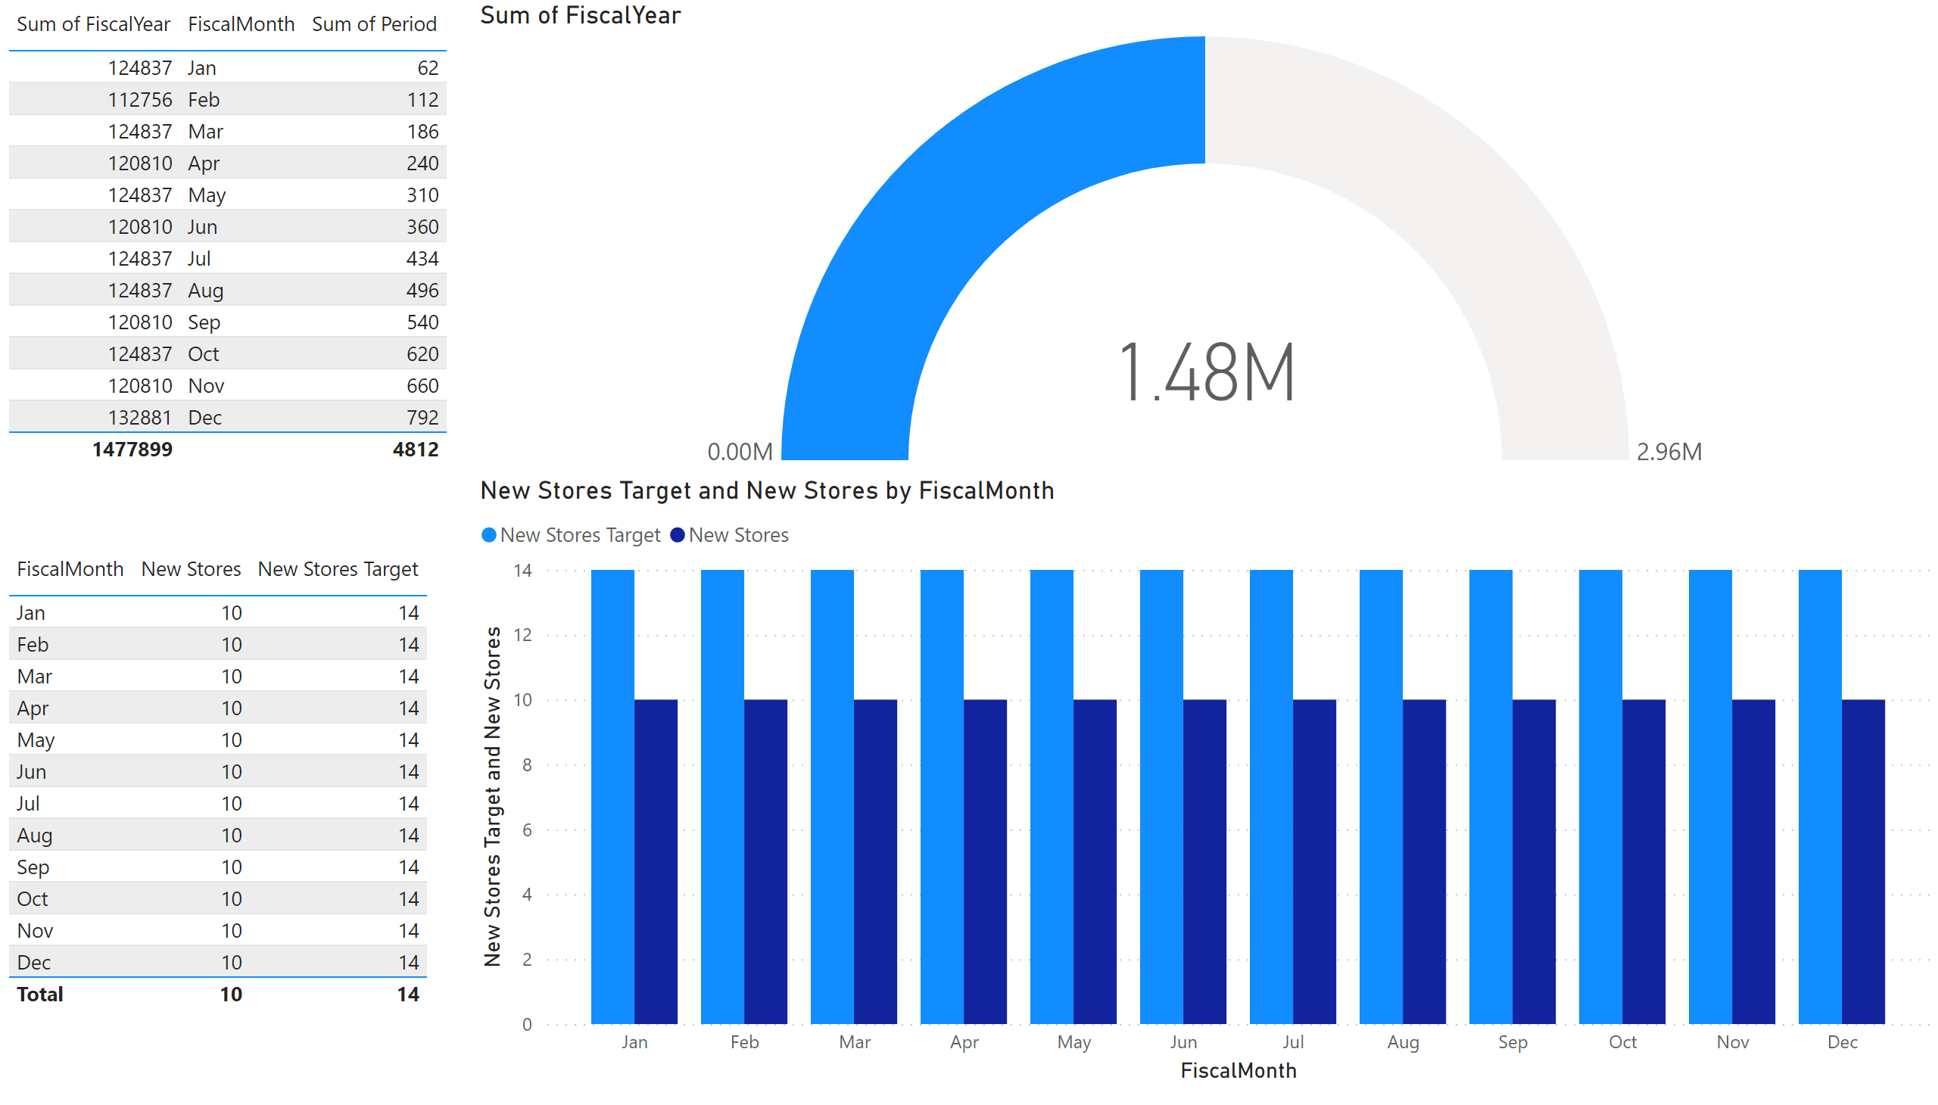
Page 8
Notes:
gauge
No alt text provided
tableEx
No alt text provided
tableEx
No alt text provided
clusteredColumnChart
No alt text provided

Slide 10
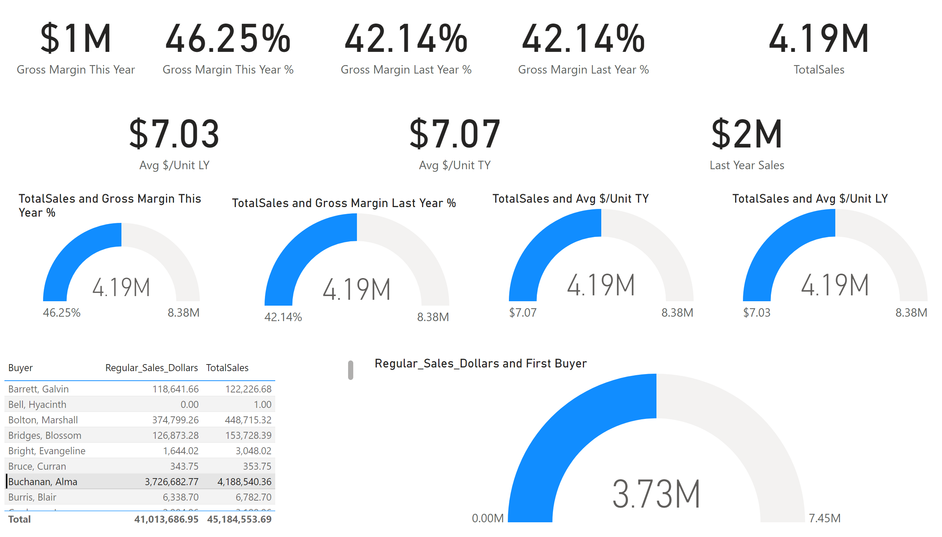
Page 9
Notes:
card
No alt text provided
card
No alt text provided
card
No alt text provided
card
No alt text provided
gauge
No alt text provided
gauge
No alt text provided
gauge
No alt text provided
gauge
No alt text provided
card
No alt text provided
card
No alt text provided
card
No alt text provided
card
No alt text provided
tableEx
No alt text provided
gauge
No alt text provided

Slide 11
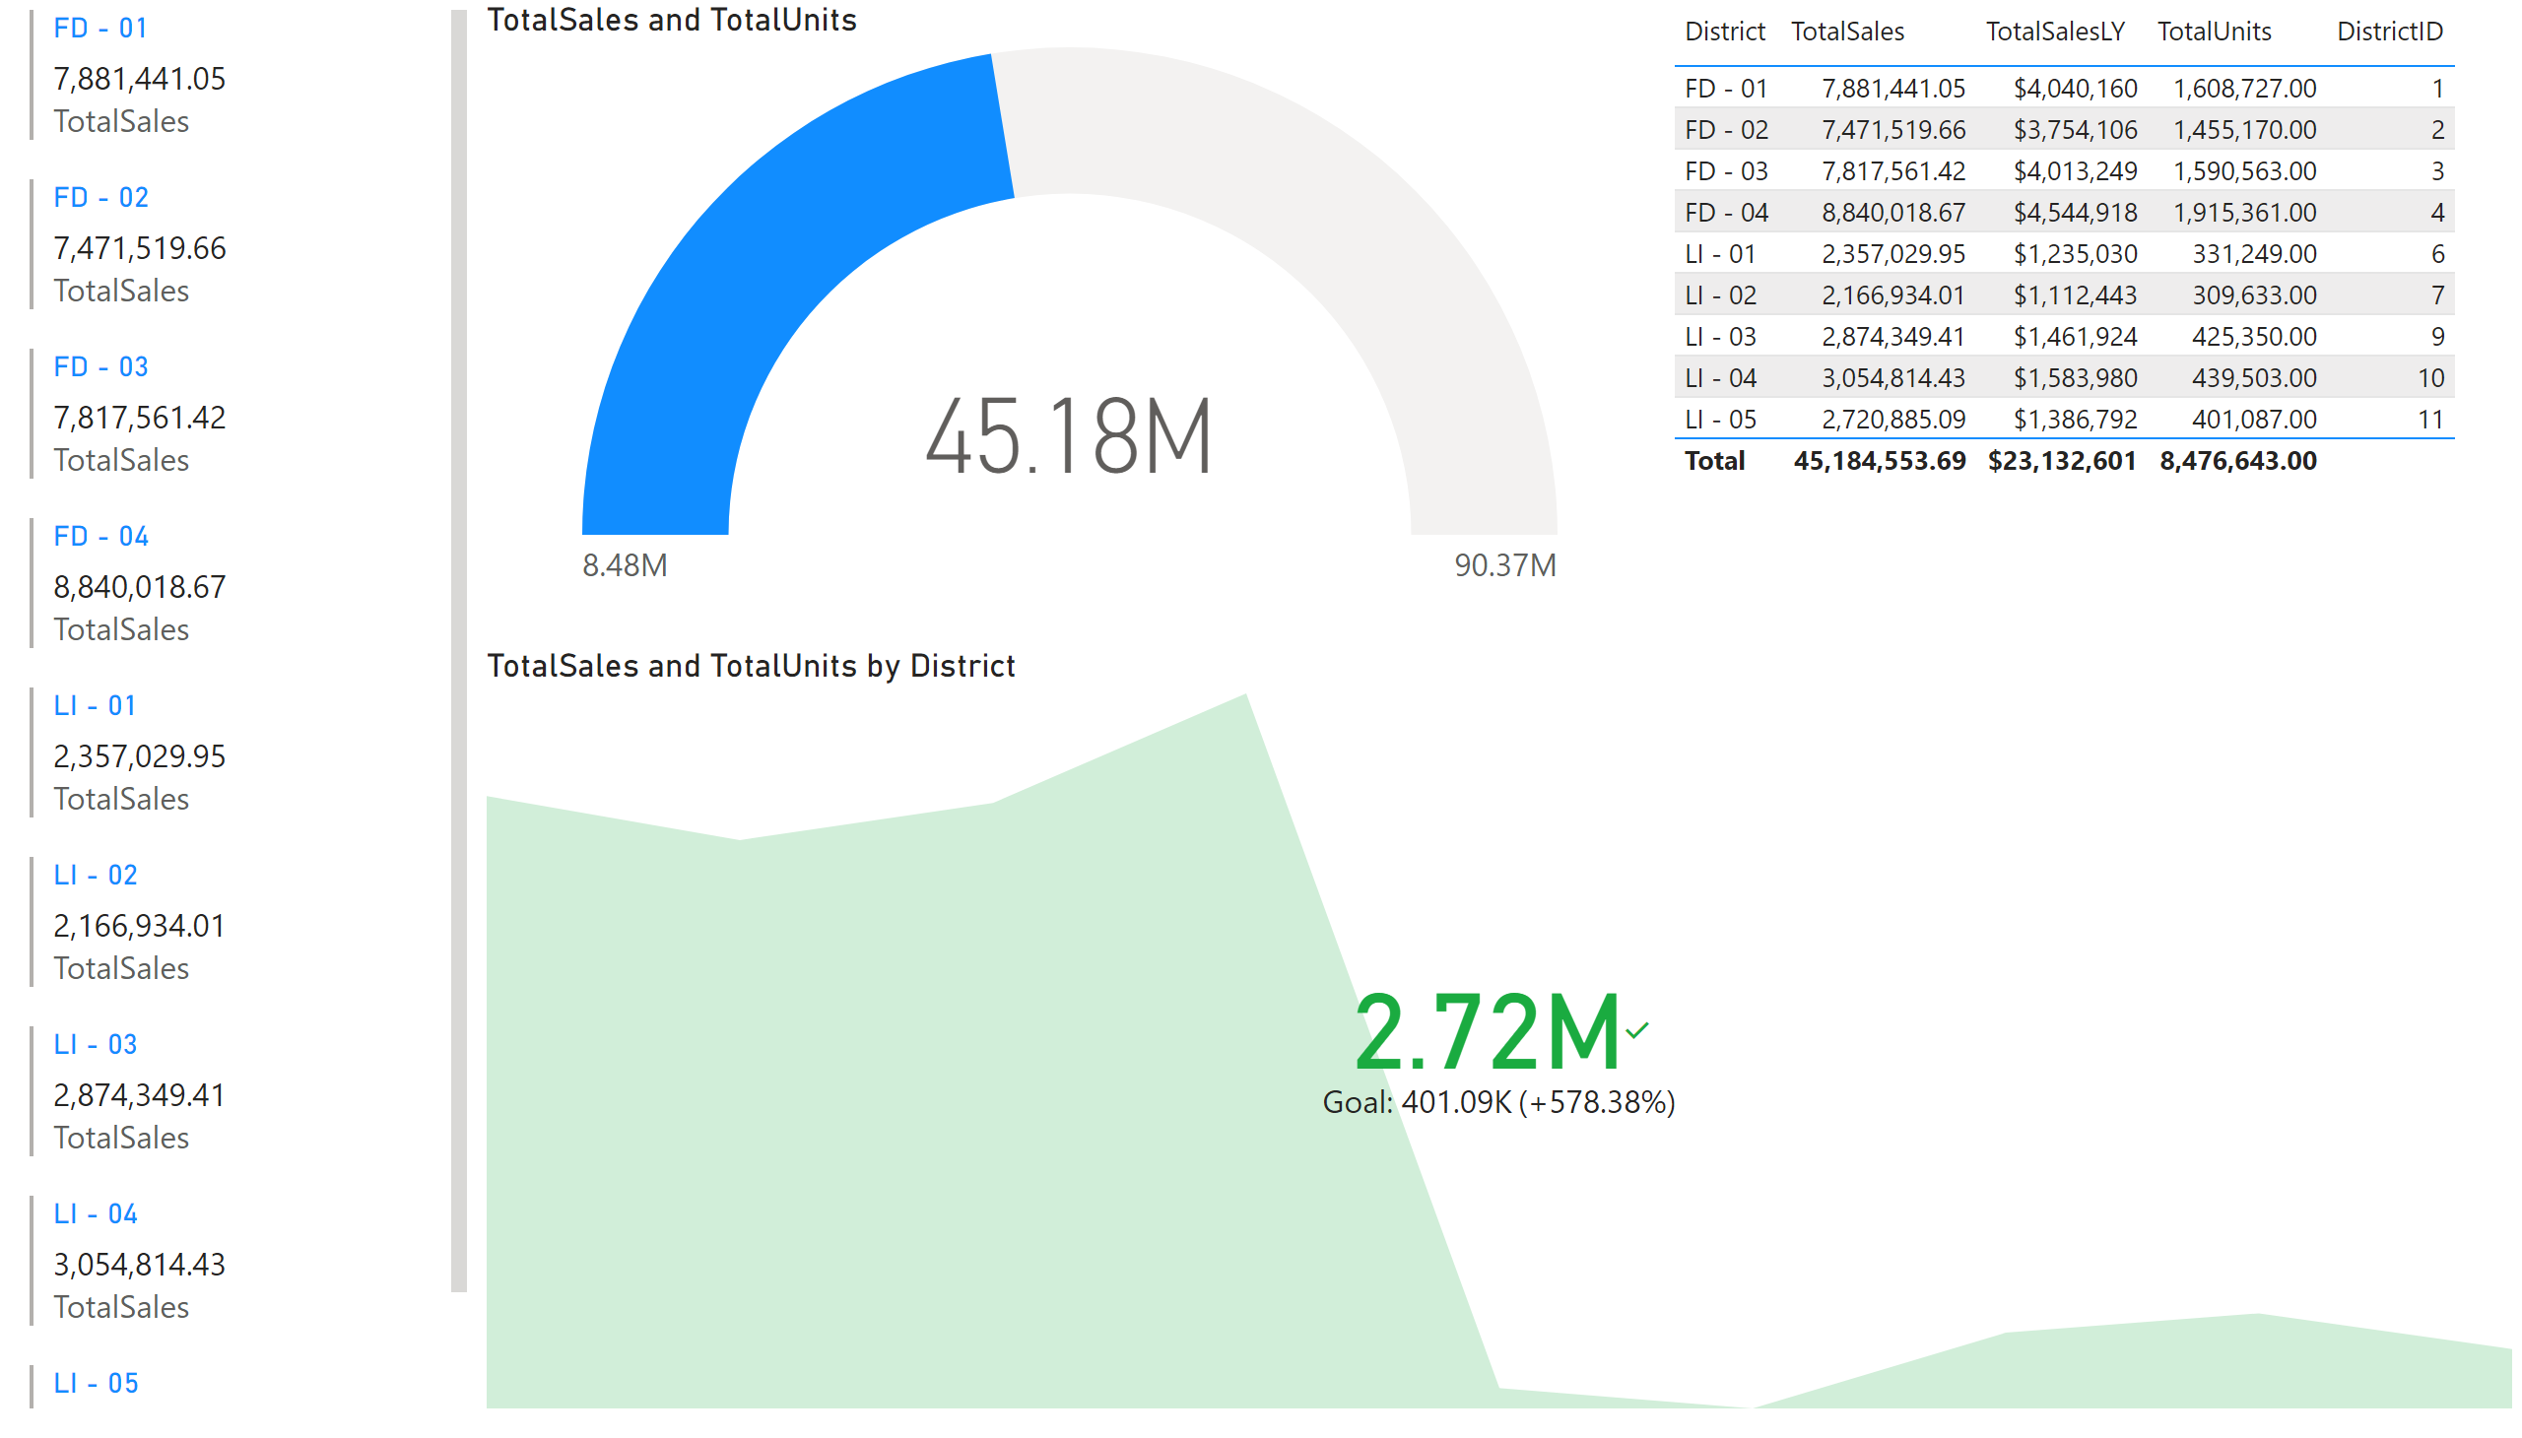
Page 10
Notes:
multiRowCard
No alt text provided
gauge
No alt text provided
tableEx
No alt text provided
kpi
No alt text provided

